Slide 1
APT 1040 INTRODUCTION TO WEB DESIGN AND APPLICATIONS
Lecture 10:
WEBSITE DESIGN USING ENHANCED CSS- Class & ID, Span and DIV

Slide 2
CSS Basics
Under standard HTML, to create a web site with <h2> tags that have the standard features of a Header tag (that is, their own paragraph, bold, with a size change) and also are dark blue, you have to code each one as follows:
<h2><font-color="darkblue">This is a darkblue H2 tag</font></h2>
That’s a lot of information to type every time you want to use a dark blue <h2> tag. Using CSS, all you need to do is type a regular <h2> tag. The style information will be included in the Style Sheet as follows:
h2 { color: darkblue;}

Slide 3
CSS Rules
To change the color of ALL <h2> tags from darkblue to green, simply change the called-for color to “green.” The next time anyone sees the site, all the <h2> tags on all the pages will be displayed as green instead of darkblue.
These styles are called rules. Each rule consists of a selector and a declaration (which is made up of a property and a value).
In the example below, h2 is the selector, color is the property, and darkblue is the value. When used with web pages, selectors are usually HTML tags.
h2 { color: darkblue;}
Syntax for a CSS rule:
selector { property: value; }

Slide 4
Grouping Styles and Selectors
Styles can be grouped:
Using multiple styles
Using multiple selectors
Using contextual selectors
Using direct child selectors
Using adjacent selectors
By attribute

Slide 5
Grouping Styles and Selectors
Each rule can include multiple styles using semicolons to separate them:
h2 { color: darkblue; font-style: italic;}
Additionally, multiple selectors that have the same styles can be grouped using commas to separate them:
h1, h2, h3 { color: yellow; }

Slide 6
Grouping Styles and Selectors
Contextual selectors allow you to specify that something will occur when it is used in conjunction with something else. In the style below, strong will be displayed in red, but only when it occurs within li within ul.
ul li strong { color: red;}
Elements being modified by contextual selectors need not appear immediately inside one another. For example, using this style, blah would still be red text: <ul><ol><li><strong> blah </strong></li></ol></ul>

Slide 7
Grouping Styles and Selectors
Direct child selectors allow you to specify that something will change, but only when immediately inside of another element. With the following style, only those strong elements that are directly inside of an h1 will be purple. No strong tags deeper within the sheet will be purple.
h1 > strong { color: purple;}

Slide 8
Grouping Styles and Selectors
Adjacent selectors allow you to specify that something will change only when preceded by something else. In the style below, only those links (a) that are preceded by an h2 will be green.
h2 + a { color: green;}
Elements being modified by adjacent selectors appear immediately after one another. Using this style, this link would be green: <h2>Visit Stanford!</h2> <a href="http://www.stanford.edu">click here</a> This link would not: <h2>Visit Stanford! <a href="http://www.stanford.edu">click here</a></h2>

Slide 9
Grouping Styles and Selectors
You can also group selectors by attribute. With the style below, text that is centered using h2 tags (<h2 align="center">) display surrounded by a dotted border:
h2[align="center"] { border: dotted;}

Slide 10
Where do you put the styles?
Style information can be located:
Externally to the pages in a site, in a separate file
Internally to each page
Inline with individual tags
Generally, creating an external style sheet file is the preferred method. To take full advantage of CSS, the Style Sheet for a site should be in an external file, so that any changes made there will apply throughout the site. This also means that only one style document has to be downloaded for a single site (making the pages load faster).

Slide 11
Style Location: External
The most common place to put style information is in an external document that each page of a web site points to directly.
Any changes made to this single document will then be applied throughout the entire web site as each page is accessed by users.
External Style Sheets have a .css extension.

Slide 12
Classes and IDs
HTML has two attributes that make CSS even more useful: class and ID. They make it easy to apply style to just about any tag.
Classes can describe a generic style that can be applied to any HTML element, or can be created for specific elements.
When defining a style for elements with a particular class attribute in the Style Sheet, declare a rule using a dot (.) followed by the class name. To limit the style to a particular element with that class attribute, use a selector combining the tag name with a dot followed immediately by the class name.
The following rule would apply to any element with the attribute class=“shade"
.shade { background: yellow; }
The following rule would apply only to paragraph tags with the class shade (<p class="shade">)
p.shade { background: red; }

Slide 13
Classes and IDs
IDs are similar to classes, but IDs are unique – they can only be used with one instance of an element within a document.
When defining a CSS rule using an ID-based selector, use a number/pound/hash sign (#) followed by the style name. To limit the style to a particular element with that ID attribute, use a selector combining the tag name with a # and then the ID name.
The following rule would apply to any element with the attribute id="intro"
#intro { font-size: 2em; }
The following rule would apply only to heading 1 tags with the id intro (<h1 id="intro">)
h1#intro { color: green; }

Slide 14
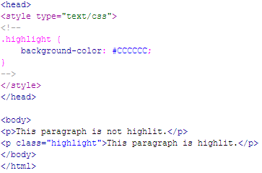

Example: Class
Here’s an example of a web page with an internal CSS style containing a class called “highlight”:

Slide 15
Inline vs. Block Display (HTML)
All HTML elements (tags) are assigned a display property value of either inline or block.
Inline elements display in browsers horizontally.
[INLINE ELEMENT 1] [INLINE ELEMENT 2] [INLINE ELEMENT 3]
Block elements display in browsers vertically (stacked one on top of the other).
[BLOCK ELEMENT 1] [BLOCK ELEMENT 2] [BLOCK ELEMENT 3]
Examples of inline elements:
<a> <img> <strong> <em> <span>
Examples of block elements:
<p> <h1-h6> <div> <hr> <table> <ul> <ol>

Slide 16
Inline vs. Block Display (CSS)
Using CSS, you can change the inherent display property:
To force a block display, use the declaration display: block;
To force an inline display, use the declaration display: inline;
To force a list, use the declaration display: list-item;
To hide elements matching the selector, use the declaration display: none;

Slide 17
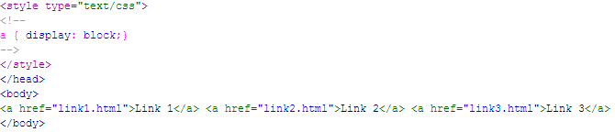

Example – display: block;
Normally, <a> tags display inline.
But, by changing the style of the a tag with a {display: block;}, they will display as a vertical navigation menu:

Slide 18

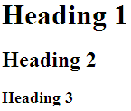
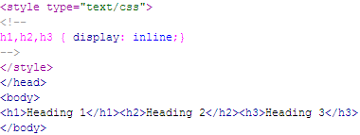

Example – display: inline;
Normally, the heading tags display in block format:
To have them display inline, add the style h1,h2,h3 {display: inline;}:

Slide 19
Span and Div
There are two tags that are particularly useful when using CSS: <span> and <div>. They are both container tags that have minimal formatting associated with them.
The <span> tag is an inline element that simply holds text without doing anything special to it.
The <div> tag is a block element and causes the text it encloses to start on a new line.
Using <span> and <div> tags in conjunction with classes and IDs allows for great flexibility in creating pages.

Slide 20
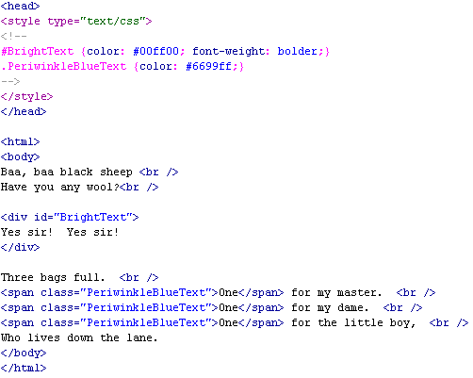
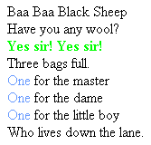
Example: SPAN, DIV, Class, and ID
Here’s an example of a web page using a class, an id, and the span and div tags:

Slide 21
Exercise
LAB
Open Lab 9 to learn more on class& ID as well as Span and DIV
Reading Assignment (ensure you do it):
Discuss the Box Model in relation to CSS

